Slide 1
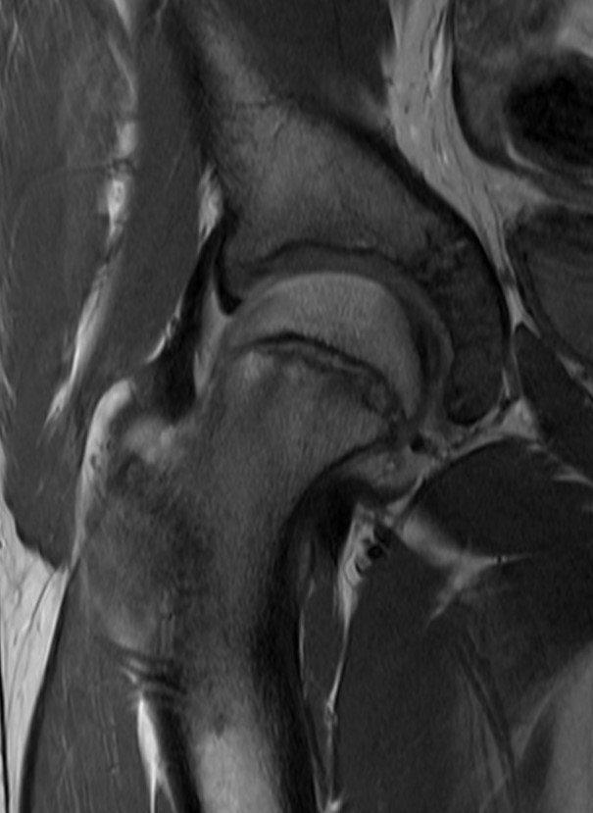
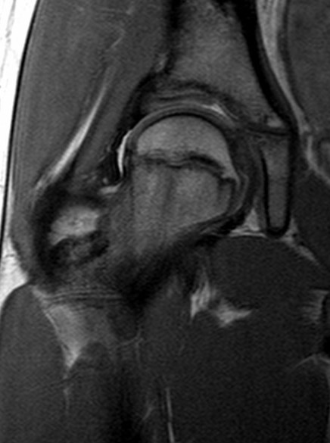
Paediatric Hip MRI

Slide 2
Indications for GP referred Medicare Rebatable MRI hip studies in children under 16 years of age
Following radiographic examination for any or the following:
suspected septic arthritis
suspected slipped capital femoral epiphysis
suspected Perthes disease

Slide 3
Traumatic & overuse causes of hip pain in children
Developmental dysplasia of the hip (DDH)
DDH usually small children but “mild” forms can present in adolescence or adulthood with labral tears +/- premature osteoarthritis
Perthe’s disease/avascular necrosis
Perthe’s usually age 3 to 10
Slipped upper femoral epiphysis (SUFE)
SUFE usually > 9 years although occasionally younger, can present with acute (i.e., traumatic Salter Harris I of prox femur), subacute or chronic symptoms
Apophyseal avulsion fractures
Apophysitis
Labral tears
Labral tears may be incidental, even in adolescence

Slide 4
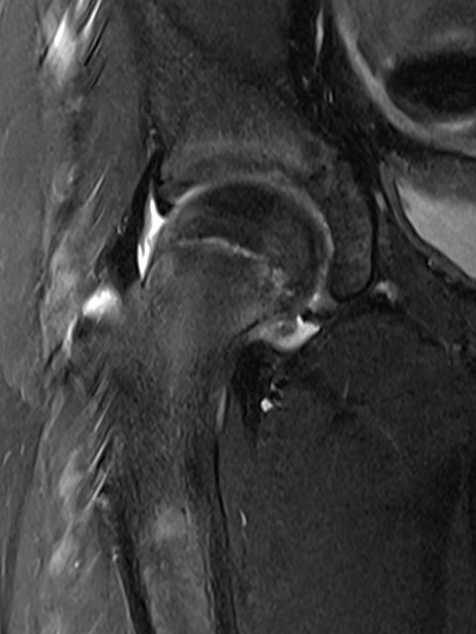
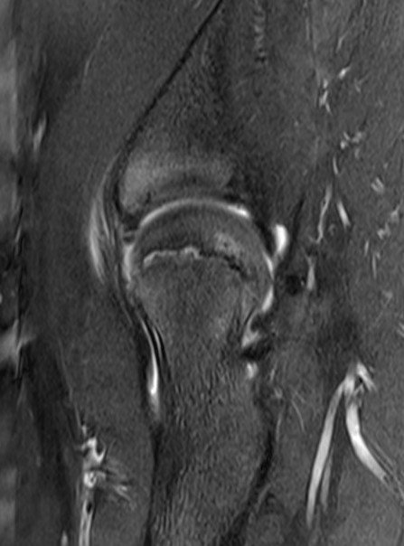
SLIPPED UPPER FEMORAL EPIPHYSIS
Subacute, 11yo girl. 3 months post fall.
Physeal widening (comparison on next slide)
Physeal hyperintensity, mild adjacent oedema
See earlier knee slide for normal vs abnormal
physis signal intensity.

Slide 5
SLIPPED UPPER FEMORAL EPIPHYSIS
Subacute, 11yo girl. 3 months post fall.
Physeal widening
(Same case as last slide)
Normal comparison – physeal cartilage (light grey central band) is thinner.

Slide 6
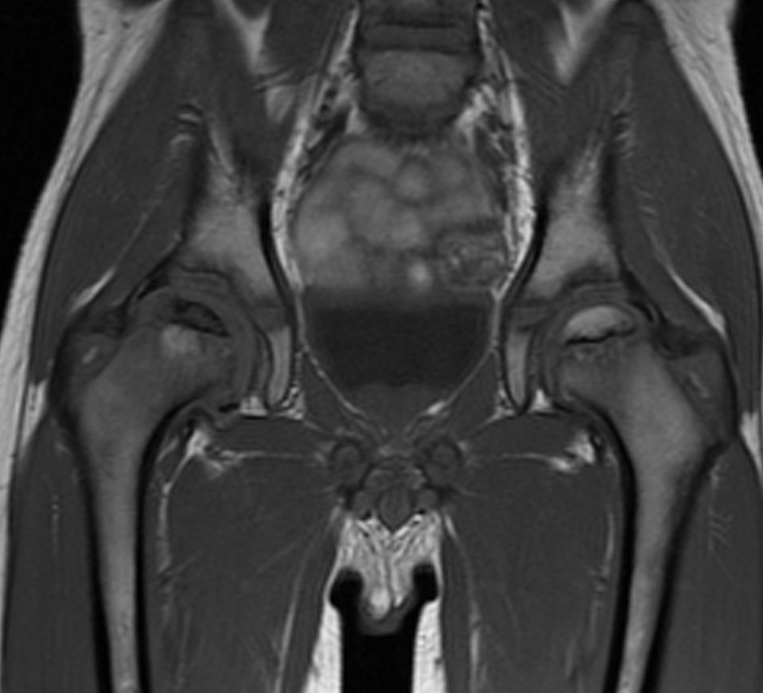
PERTHE’S DISEASE 6 yr old boy with hip pain
Sclerosis and flattening of the right capital femoral epiphysis, which appears dark in comparison to the normal left side due to loss of normal fatty marrow.
There is involvement of the growth plate, a complication that can lead to premature fusion.
Normal fat signal (bright) maintained within the left capital femoral epiphysis. Compare to other normal bone marrow in the field of view. Some milder grey areas are normal red marrow at this age – still much brighter than the abnormal right femoral head.

