Slide 1
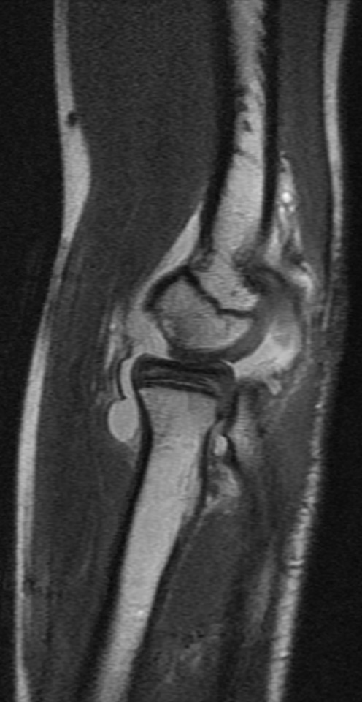
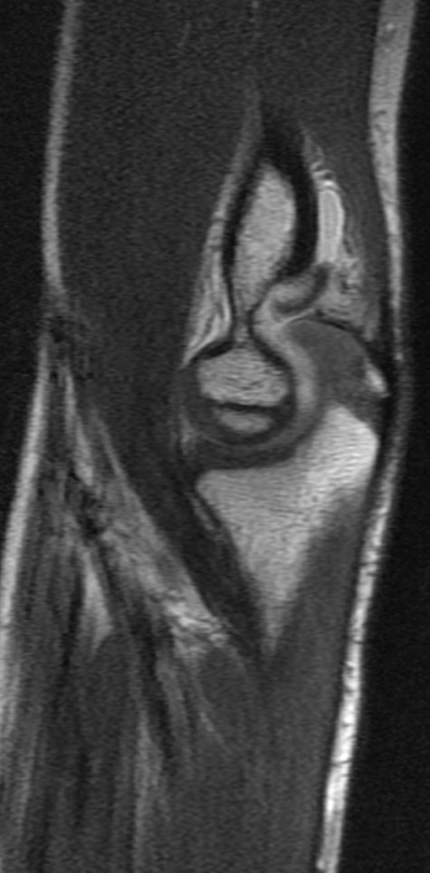
Paediatric Elbow MRI

Slide 2
Indications for GP referred Medicare Rebatable MRI elbow studies in children under 16 years of age
Following radiographic examination:
where a significant fracture or avulsion injury is suspected that will change management
Note:
May be acute or chronic pain

Slide 3
Traumatic & overuse causes of elbow pain in children
Apophyseal avulsion (medial epicondyle most common)
Ligamentous avulsion/tears
Acute fractures
Medial and lateral condylar fractures may be occult in small children due to unossified epiphysis
Elbow dislocation
Dislocation often combines ligamentous injury, avulsion, fracture and osteochondral injury
Apophysitis
Panner’s disease (AVN of capitellum)
Osteochondritis dissecans
Stress fractures
Upper limb stress fractures with certain sports such as gymnastics

Slide 4
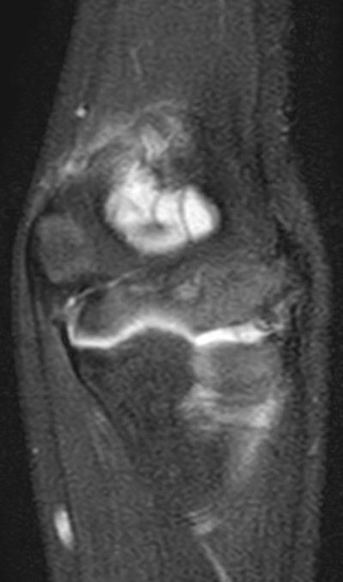
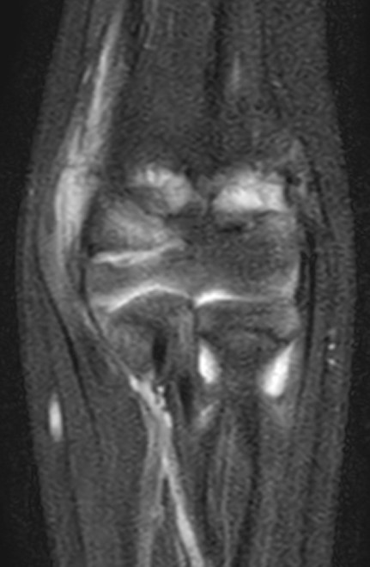
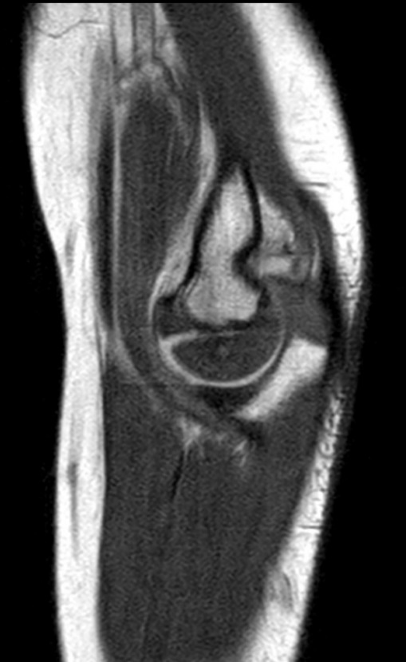
5 year old boy with a cartilaginous intraarticular epiphyseal fracture (medial condyle)
MRI permits evaluation of the unossified cartilaginous epiphysis in young children, unlike xray.
Intraarticular fracture line across epiphyseal cartilage (invisible at xray), filled with bright joint fluid.
The proton density image to the right shows the contrast between the normal grey cartilage of the distal humeral epiphysis versus the bright bone marrow. The olecranon apophysis is also cartilage at this age so grey signal. In adults, these would all be ossified.
This study in a 5 year old was performed without general anaesthetic or sedation. The images are diagnostic despite a little blurring.

Slide 5
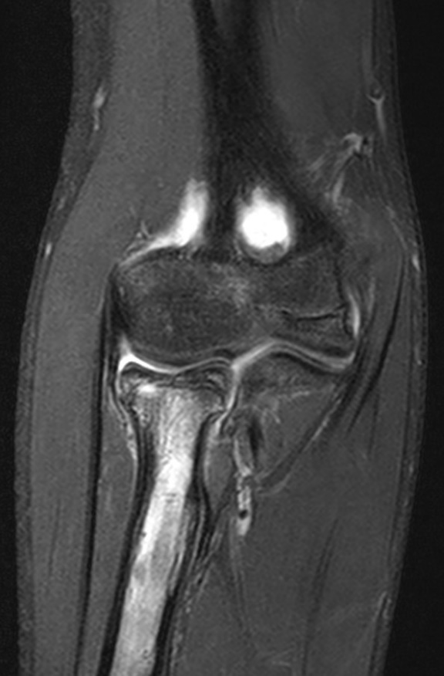
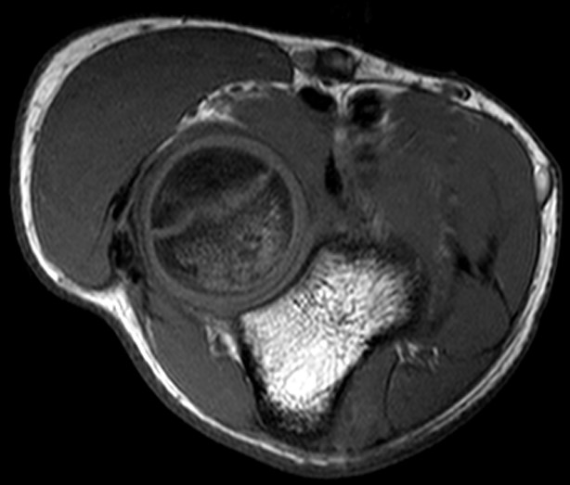
Stress fracture of the radius. 13 year old gymnast with ongoing elbow pain. No specific episode of trauma.
MRI SHOWING FRACTURE
Bone marrow oedema within proximal radius
Intraarticular fracture line of radial head

Slide 6
12 year old boy with elbow pain and swelling several weeks following an injury.
ACUTE OSTEOCHONDRAL FRACTURE
Osteochondral defect in the anterior capitellum
Displaced fragment in olecranon fossa

